Slide 1








Slide 2






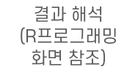









Slide 3



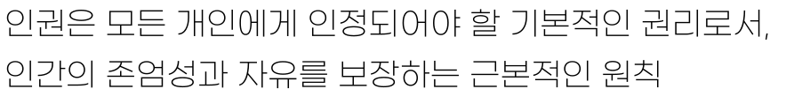




Slide 4

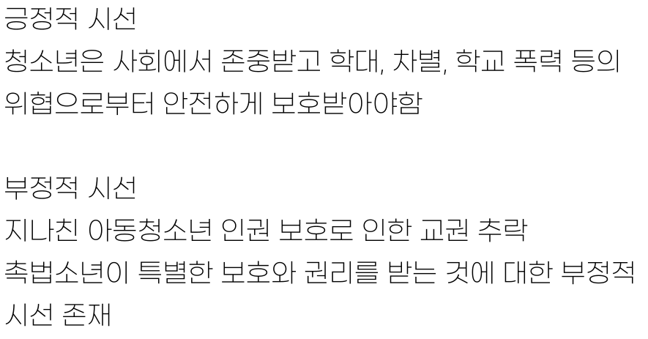

Slide 5
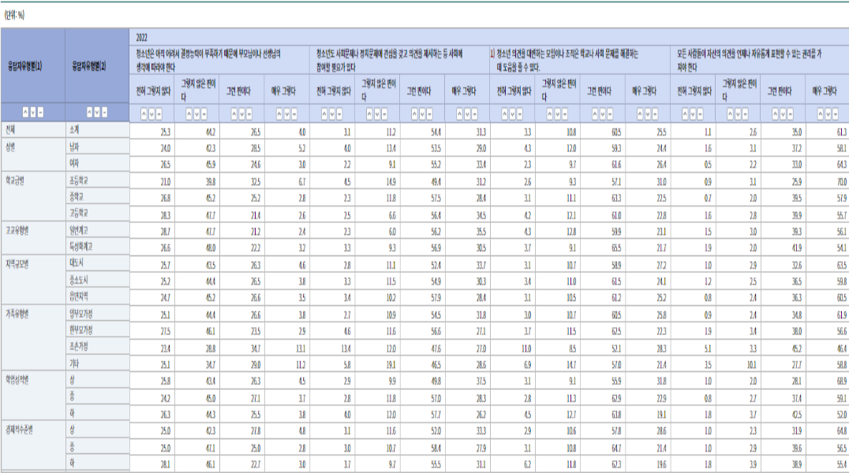
https://kosis.kr/statHtml/statHtml.do?orgId=402&tblId=DT_ES2017_003_1&vw_cd=MT_ZTITLE&list_id=402_siew6548_2017_10_10&scrId=&seqNo=&lang_mode=ko&obj_var_id=&itm_id=&conn_path=MT_ZTITLE&path=%252FstatisticsList%252FstatisticsListIndex.do

Slide 6







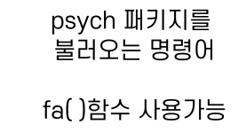
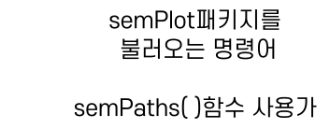
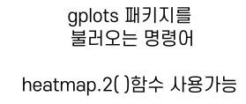
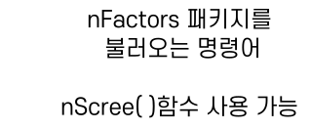

Slide 7






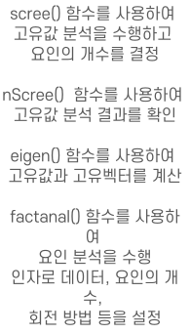
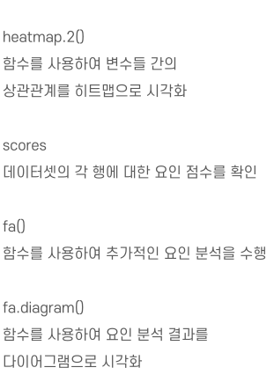


Slide 8





